Slide 1

Vsphere Provider
info@zekeLabs.com | www.zekeLabs.com | +91 8095465880

Slide 2
VMware Architecture
info@zekeLabs.com | www.zekeLabs.com | +91 8095465880

Slide 3
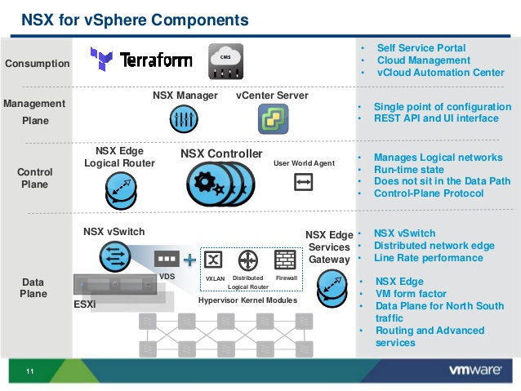
info@zekeLabs.com | www.zekeLabs.com | +91 8095465880

Slide 4
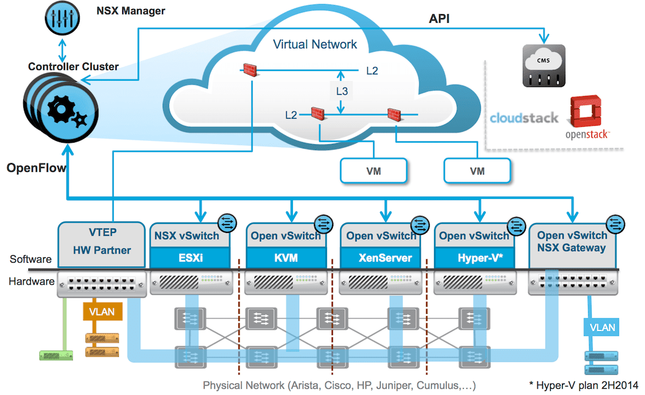
info@zekeLabs.com | www.zekeLabs.com | +91 8095465880

Slide 5
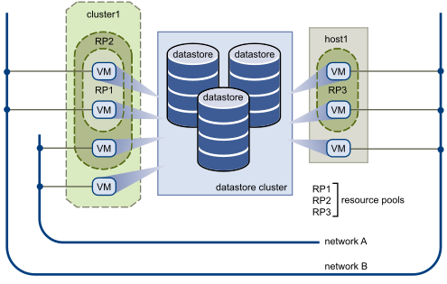
Vsphere datacenter Architecture

Slide 6
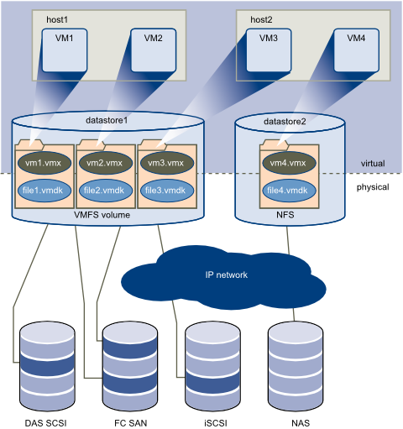
Vsphere storage Architecture

Slide 7
VSphere: data sources
vsphere_compute_cluster
vsphere_datacenter
vsphere_datastore
vsphere_datastore_cluster
vsphere_distributed_virtual_switch
Vsphere_host
vsphere_resource_pool
vsphere_network
vsphere_virtual_machine
Vsphere_vmfs_disks
vsphere_tag
vsphere_tag_category
vsphere_custom_attribute
info@zekeLabs.com | www.zekeLabs.com | +91 8095465880

Slide 8
VSphere: Resources
Administration Resources
Host and Cluster Management Resources
Inventory Resources
Networking Resources
Storage Resources
Virtual Machine Resources
info@zekeLabs.com | www.zekeLabs.com | +91 8095465880

Slide 9
Lab
info@zekeLabs.com | www.zekeLabs.com | +91 8095465880

Slide 10
THANK YOU
Let us know how can we help your organization to Upskill the employees to stay updated in the ever-evolving IT Industry.
Get in touch:
www.zekeLabs.com | +91-8095465880 | info@zekeLabs.com
Visit : www.zekeLabs.com for more details

